Slide 1
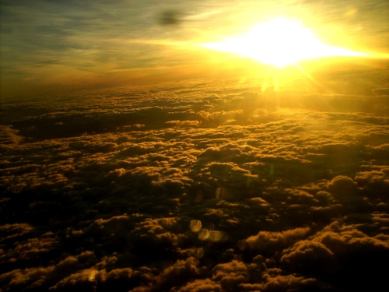
Christ's Future Rule in Jerusalem
Isaiah 2:1-5; 4:2-6
Christology: The Person & Work of Jesus
Dr. Rick Griffith • Jordan Evangelical Theological Seminary • BibleStudyDownloads.org

Slide 2
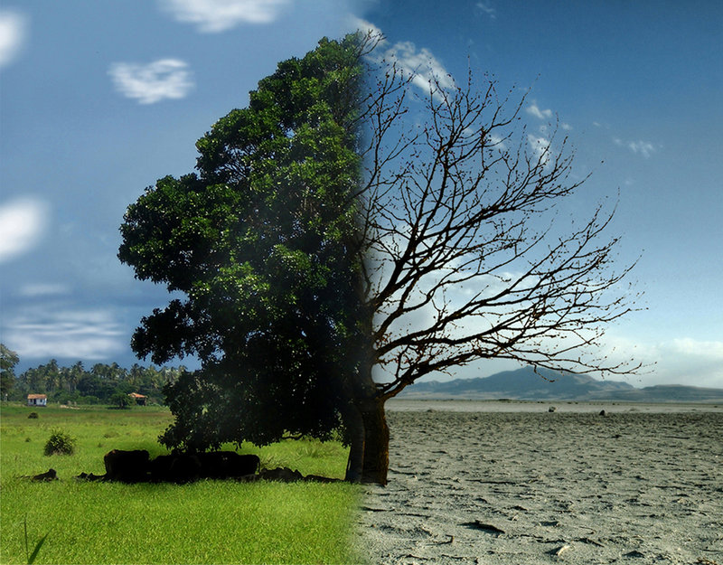
What in the world is happening?
Good
Bad
Notes:
Not too many people today feel that the world is getting better. Most say it is getting worse.
Financially the currencies are no longer backed by gold.
The family has fallen apart in most, if not all, countries.
Ethnic and religious conflicts abound.

Slide 3
What in the world is happening?
Do you have hope it will get better?
Good
Bad
Notes:
Do you think the next US president will turn the tide?
Do you think Singapore will be less crowded in the future?
Do you feel Singapore will become more affordable?
Have you ever heard a sermon on what the world will be life after Jesus returns?

Slide 4
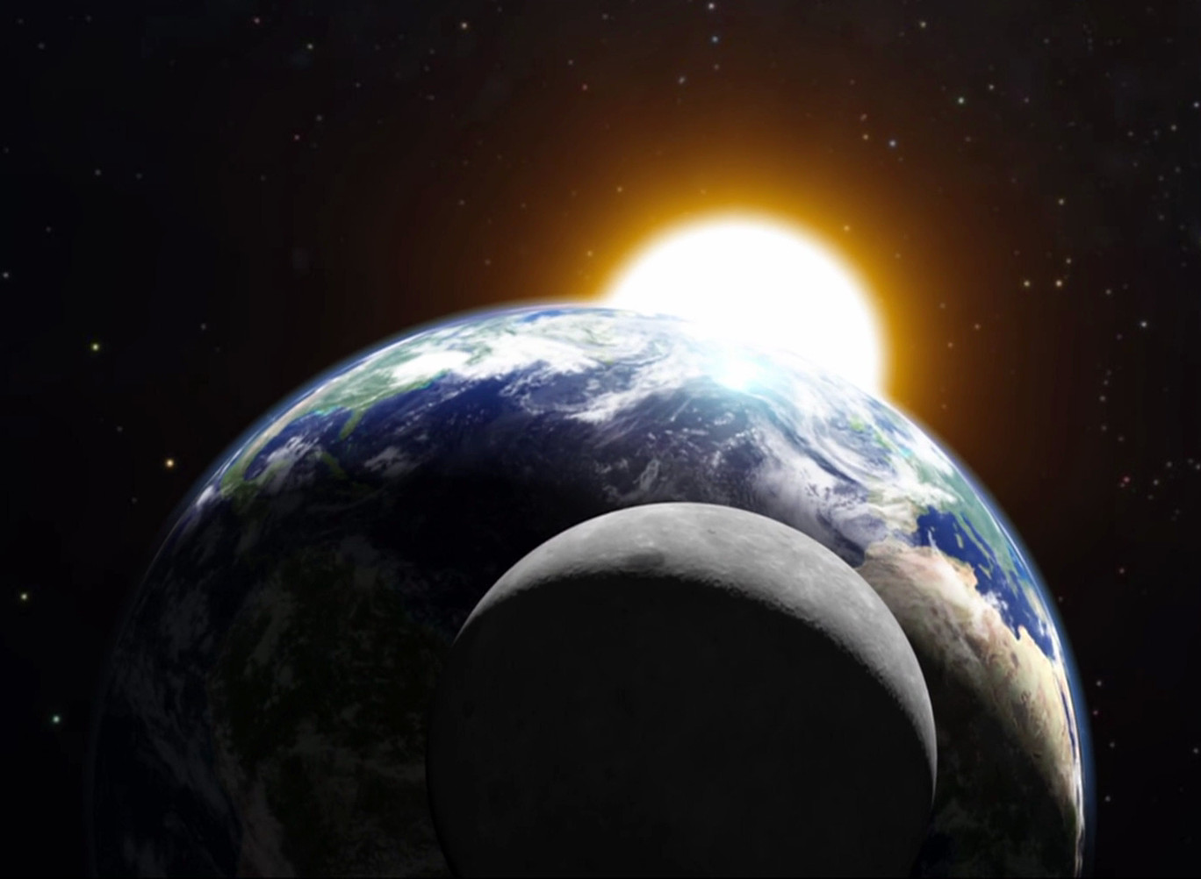
What will it be like when Christ rules this world?

Slide 5
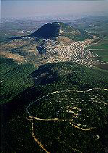
Life in Isaiah's Day
(735 BC)

Slide 6
The Assyrian Threat
454
Assyrian Expansion
Nineveh
Mediterranean
Sea
Aram
Israel
Judah
700s BC
Persian
Gulf
Egypt
Notes:
6

Slide 7

When Isaiah Wrote
453
End of the
Kings of Israel
Pekah
Hoshea
Kings of Judah
Uzziah
Jotham
Ahaz
Hezekiah
Isaiah's 60 Year Ministry
(740-680 BC)
Notes:
7

Slide 8
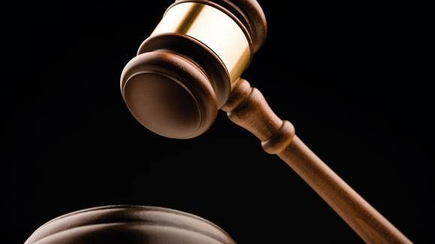
Isaiah 1
When God Takes His People to Court
Dr. Rick Griffith, Crossroads International Church, Singapore
www.biblestudydownloads.com

Slide 9
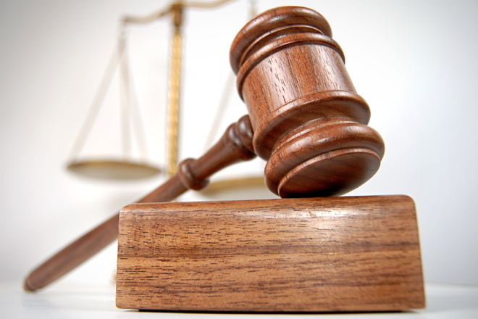
Court Procedure
Charge
Evidence
Verdict

Slide 10
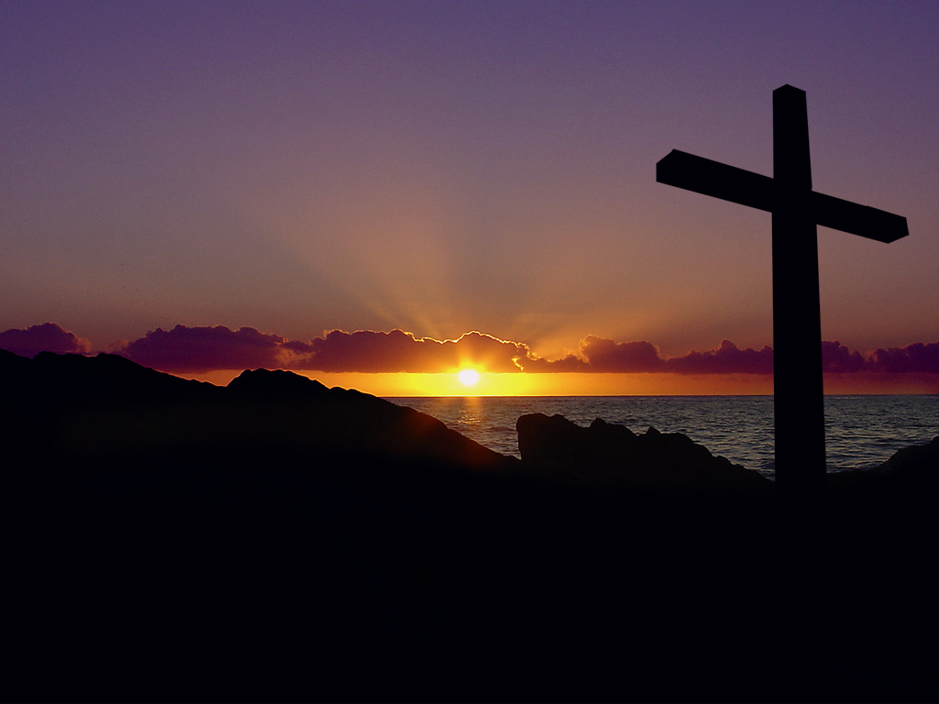
Isaiah 1 Main Idea
When rituals replace relationship, repent for restoration.
Notes:
Turn to God instead of religion—so don't be religious, be restored!
This comes through a change of mind (repentance) followed by the fruits of repentance (justice)

Slide 11
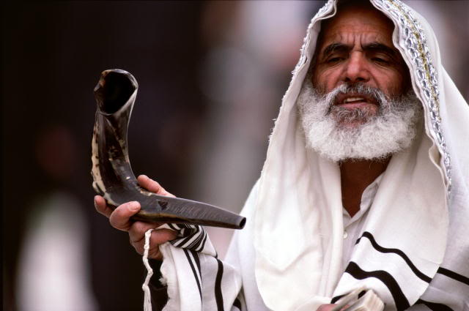
Two Key Texts:
Isaiah 2:1-5
Isaiah 4:2-6

Slide 12

I. Jesus will bring worldwide truth and peace (2:1-5).
Notes:
Christ will give us all God's values that will finally help us get along.

Slide 13
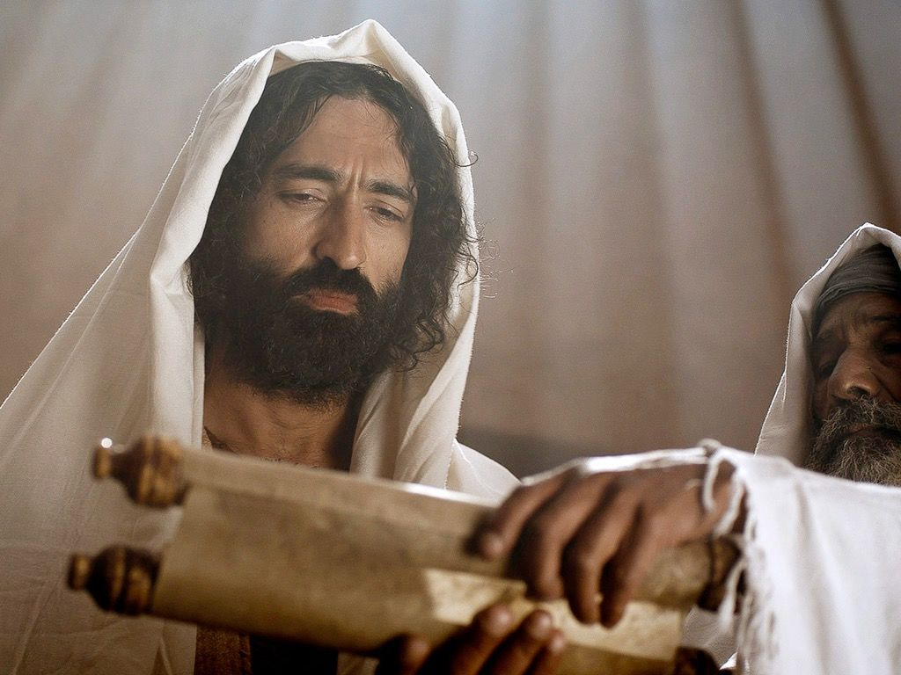
Christ will teach all people from Temple Mount (2:1-3)

Slide 14
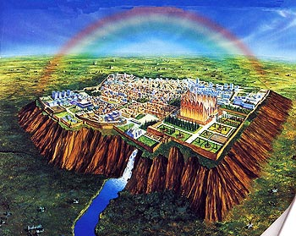
"In the last days,
the mountain of the LORD's house
will be the highest of all—
the most important place on earth.
It will be raised above the other hills,
and people from all over the world will stream there to worship"
(Isa. 2:2 NLT).

Slide 15

Solomon's Temple
502
Ezekiel 8:4

Slide 16
Solomon's Temple
502
Ezekiel 9:3

Slide 17
Solomon's Temple
502
Ezekiel 10:4

Slide 18
Solomon's Temple
502
Ezekiel 10:18-19

Slide 19

The Glory Leaving
502
Ezekiel 11:23

Slide 20
The Glory Returns
502
Ezekiel

Slide 21
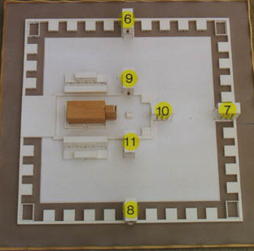
Ezekiel's temple won't fit on the present Temple Mount!
Ezekiel 40–43
521
www.pauljab.net/temple/ TemplePictures.html

Slide 22
Who copied whom?
ESV Isaiah 2:2 It shall come to pass in the latter days that the mountain of the house of the LORD shall be established as the highest of the mountains, and shall be lifted up above the hills; and all the nations shall flow to it,
ESV Micah 4:1 It shall come to pass in the latter days that the mountain of the house of the LORD shall be established as the highest of the mountains, and it shall be lifted up above the hills; and peoples shall flow to it,
Notes:
22

Slide 23
Who copied whom?
ESV Isaiah 2:3 and many peoples shall come, and say: "Come, let us go up to the mountain of the LORD, to the house of the God of Jacob, that he may teach us his ways and that we may walk in his paths." For out of Zion shall go the law, and the word of the LORD from Jerusalem.
ESV Micah 4:2 and many nations shall come, and say: "Come, let us go up to the mountain of the LORD, to the house of the God of Jacob, that he may teach us his ways and that we may walk in his paths." For out of Zion shall go forth the law, and the word of the LORD from Jerusalem.
Notes:
23

Slide 24
Who copied whom?
ESV Isaiah 2:4 He shall judge between the nations, and shall decide disputes for many peoples; and they shall beat their swords into plowshares, and their spears into pruning hooks; nation shall not lift up sword against nation, neither shall they learn war anymore.
ESV Micah 4:3 He shall judge between many peoples, and shall decide for strong nations afar off; and they shall beat their swords into plowshares, and their spears into pruning hooks; nation shall not lift up sword against nation, neither shall they learn war anymore
Notes:
24

Slide 25

461b
Millennial Jerusalem
"The law will go out from Zion,
the word of the LORD from Jerusalem"
—Isaiah 2:3
Notes:
25

Slide 26
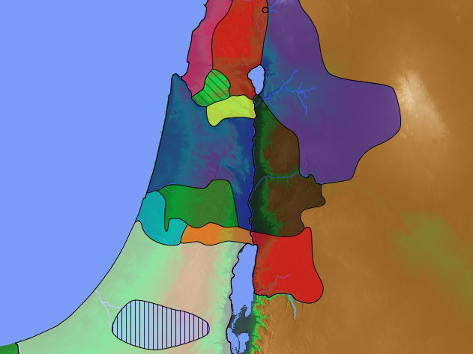
48 Levitical Cities
171a
6 Cities of Refuge

Slide 27

The Teacher

Slide 28
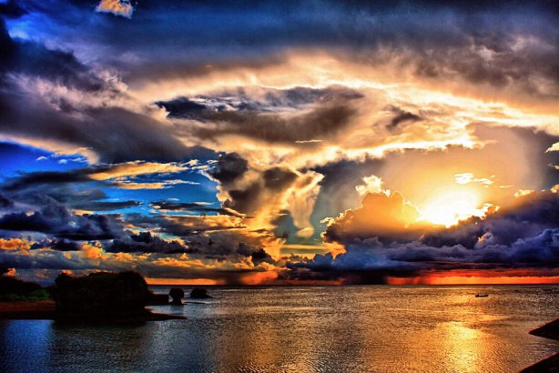
Christ will bring worldwide peace (2:4)
"He will judge between the nations and will settle disputes for many peoples" (4a).
Notes:
Christ will judge between countries at the worldwide court (2:4a).
What kind of disputes will Jesus settle among the nations (2:4a)? All arguments!
I think this means that the nations are going to stop arguing with each other as they have done for millennia.

Slide 29
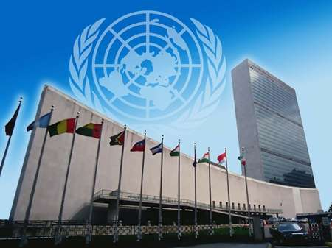
United Nations Building, New York

Slide 30
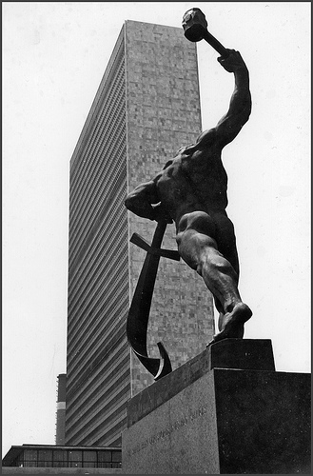
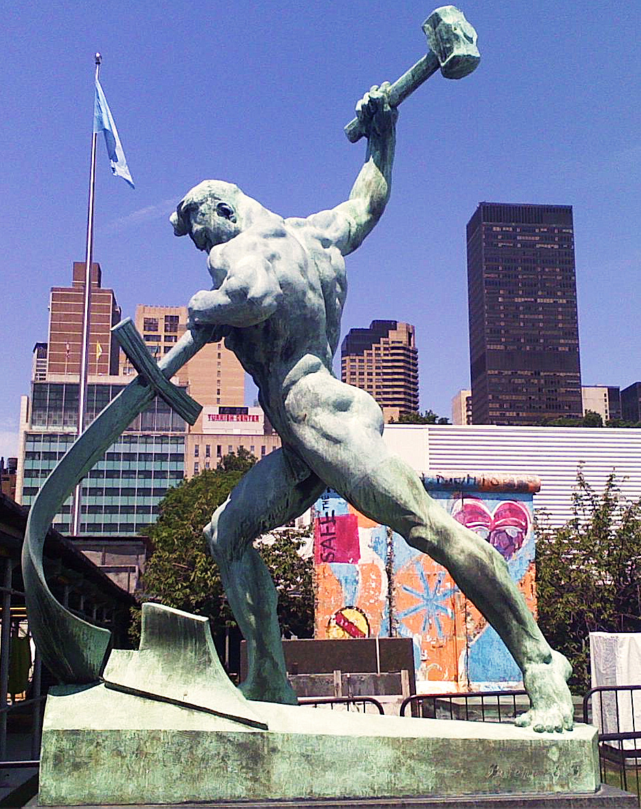
United Nations Building (New York)
Notes:
"Let Us Beat Swords into Plowshares
But first...
What is a plowshare?!
A plowshare is part of a plow. It is the leading edge that cuts
into the earth when turning over the dirt.
Let Us Beat Swords into Plowshares was sculpted
by Yevgeny Vuchetich. It was donated to the UN by the USSR in 1959.
The sculpture stands in the garden of the UN Headquarters."
https://sites.google.com/site/cdaunexploration/let-us-beat-swords-into-plowshares
Accessed 8 July 2015

Slide 31
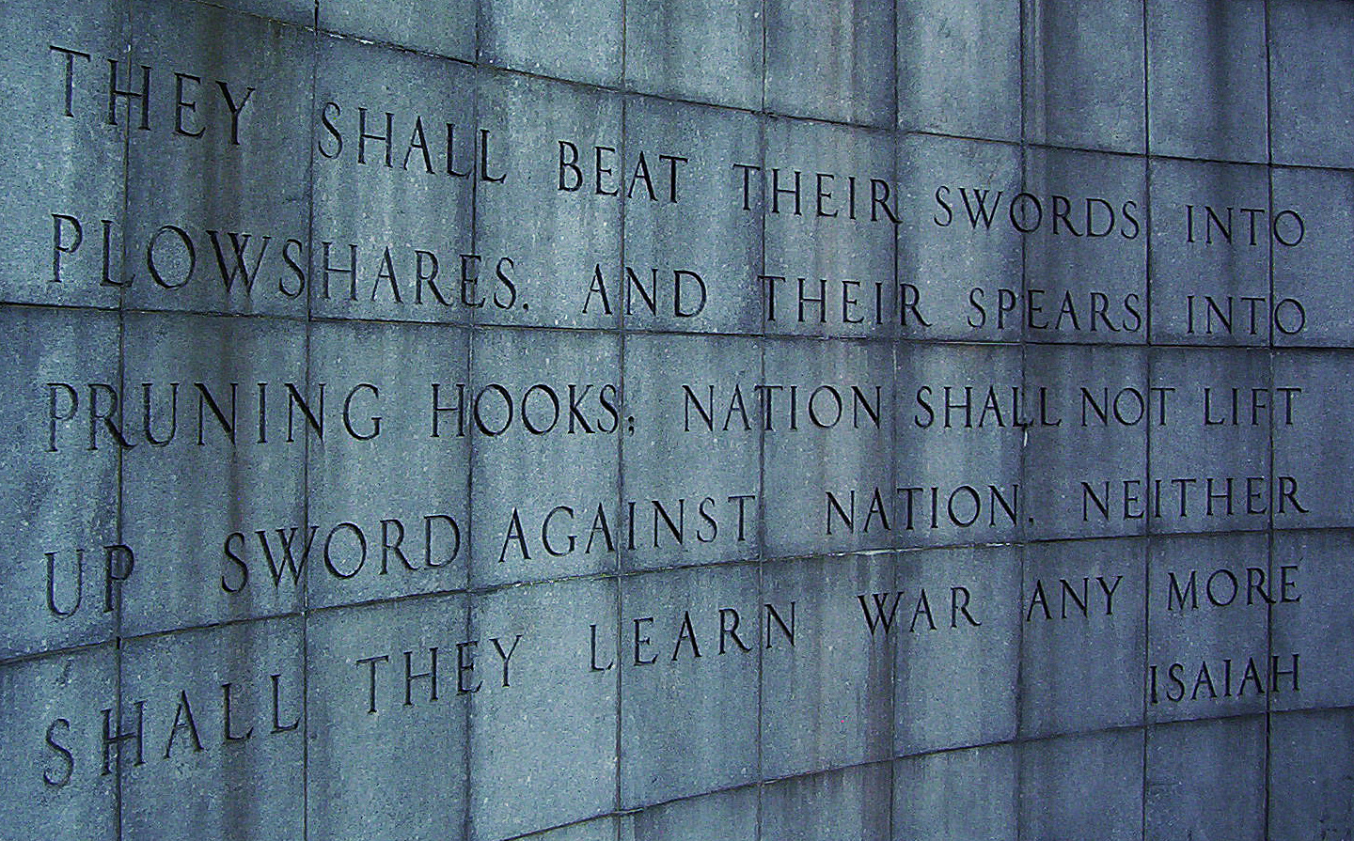
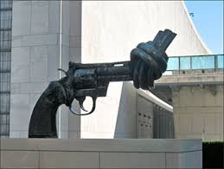
United Nations Building, New York

Slide 32
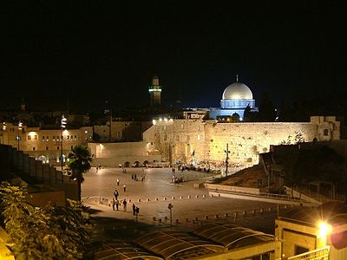
"The LORD has sworn to Jerusalem by his own strength: 'I will never again hand you over to your enemies. Never again will foreign warriors come and take away your grain and new wine'"
(Isa. 62:8 NLT).

Slide 33
I. Jesus will bring worldwide truth and peace (2:1-5).
Notes:
Christ will give us all God's values that will finally help us get along.

Slide 34
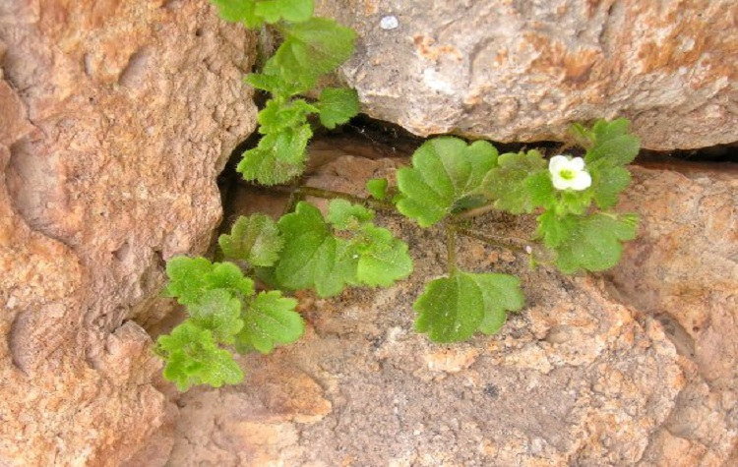
II. Jesus will bring worldwide prosperity, holiness and protection (4:2-6).
Notes:
Christ will give us all God's values that will finally help us get along.

Slide 35

"In that day the Branch of the LORD will be beautiful and glorious, and the fruit of the land will be the pride and glory of the survivors in Israel" (4:2 NIV).

Slide 36
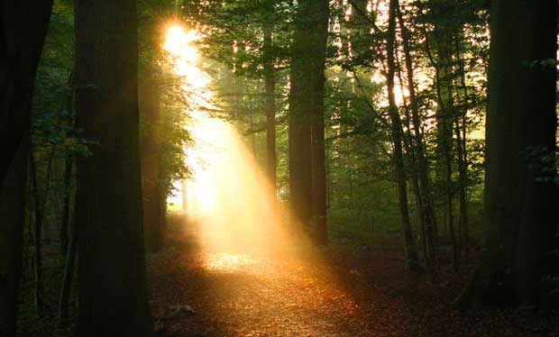
The Branch
"The prophet looked beyond the 'day of the Lord' to that time when the kingdom will be established on earth. 'Branch of the Lord' is a messianic title for Jesus Christ, who came as a 'shoot' from the seeming dead stump of David's dynasty (11:1; 53:2; see Jer. 23:5; 33:15; Zech. 3:8; 6:12). God will cleanse His people (Isa. 4:4; see Zech. 12:10–13:1), restore the fruitfulness of the land, and dwell with them as He did when He led them through the wilderness (Isa. 4:5–6; Ex. 13:21–22). Not just the temple, but every dwelling will be blessed by the presence of the Lord! Unlike in Isaiah's day, 'in that day' the people will be holy (set apart), and the land will be beautiful and glorious"
(Warren W. Wiersbe, Be Comforted: Feeling Secure in the Arms of God, 33).
Notes:
"The prophet looked beyond the 'day of the Lord' to that time when the kingdom will be established on earth. 'Branch of the Lord' is a messianic title for Jesus Christ, who came as a 'shoot' from the seeming dead stump of David's dynasty (11:1; 53:2; see Jer. 23:5; 33:15; Zech. 3:8; 6:12). God will cleanse His people (Isa. 4:4; see Zech. 12:10–13:1), restore the fruitfulness of the land, and dwell with them as He did when He led them through the wilderness (Isa. 4:5–6; Ex. 13:21–22). Not just the temple, but every dwelling will be blessed by the presence of the Lord! Unlike in Isaiah's day, 'in that day' the people will be holy (set apart), and the land will be beautiful and glorious" (Warren W. Wiersbe, Be Comforted: Feeling Secure in the Arms of God, 33).

Slide 37

"In that day the Branch of the LORD will be beautiful and glorious, and the fruit of the land will be the pride and glory of the survivors in Israel"
(4:2 NIV).

Slide 38
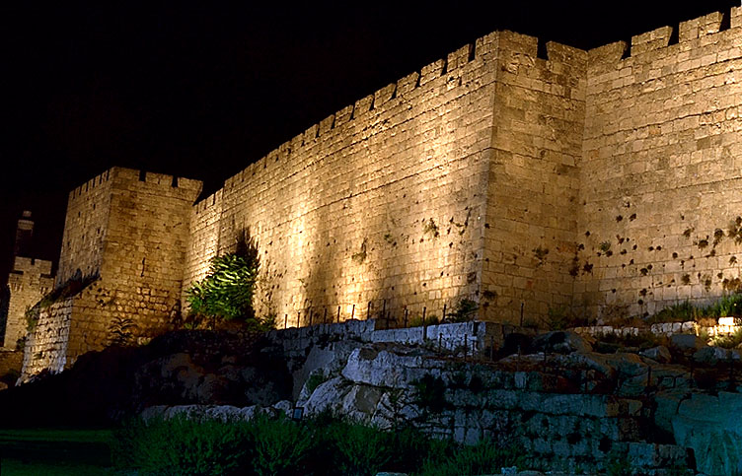
"O Jerusalem, I have posted watchmen on your walls; they will pray day and night, continually.
Take no rest, all you who pray to the LORD. ⁷Give the LORD no rest until he completes his work, until he makes Jerusalem the pride of the earth" (Isa. 62:6-7 NLT).

Slide 39

Christ will make holy Jerusalem's remnant in mortal bodies (4:3-4).

Slide 40
A Look at the Future
473
Great
White
Throne
(Rev. 20:11-14)
Rapture
(1 Thess. 4:13-18)
2nd Advent
(Zech. 14:3-5)
Church Age
Tribulation
(Zech. 14:1-2)
Millennium
(Zech. 14:6-21)
Gog & Magog
(Armageddon)
(Ezek. 38–39)
Gog and Magog
Revisited
(Rev. 20:7-10)
Notes:
40

Slide 41
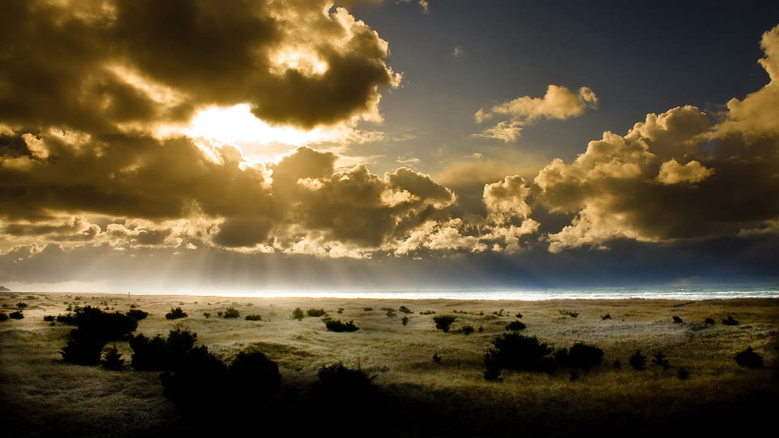
Christ will protect Jerusalem's citizens from the sun and rain (4:5-6).

Slide 42
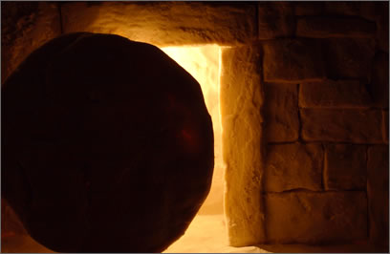
Main Idea of Isaiah 2:1-5; 4:2-6
Jesus will bring worldwide truth, peace, prosperity, holiness and protection

Slide 43
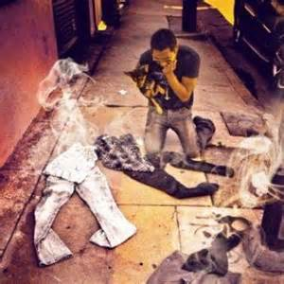
Main Idea

Slide 44


Revelation 20:4-6 Diagrammed
NTS 424
^{4b}and they came to life and reigned with Christ for a thousand years.
^{4a}Then I saw thrones, and they sat on them, and judgment was given to them. And I saw the souls of those who had been beheaded because of their testimony of Jesus and because of the word of God, and those who had not worshiped the beast or his image, and had not received the mark on their forehead and on their hand…
1000 years
^{5b}This is the first resurrection. ^{6a}Blessed and holy is the one who has a part in the first resurrection; over these the second death has no power…
^{6b}but they will be priests of God and of Christ and will reign with Him for a thousand years.
^{5a}The rest of the dead did not come to life until the thousand years were completed.

Slide 45
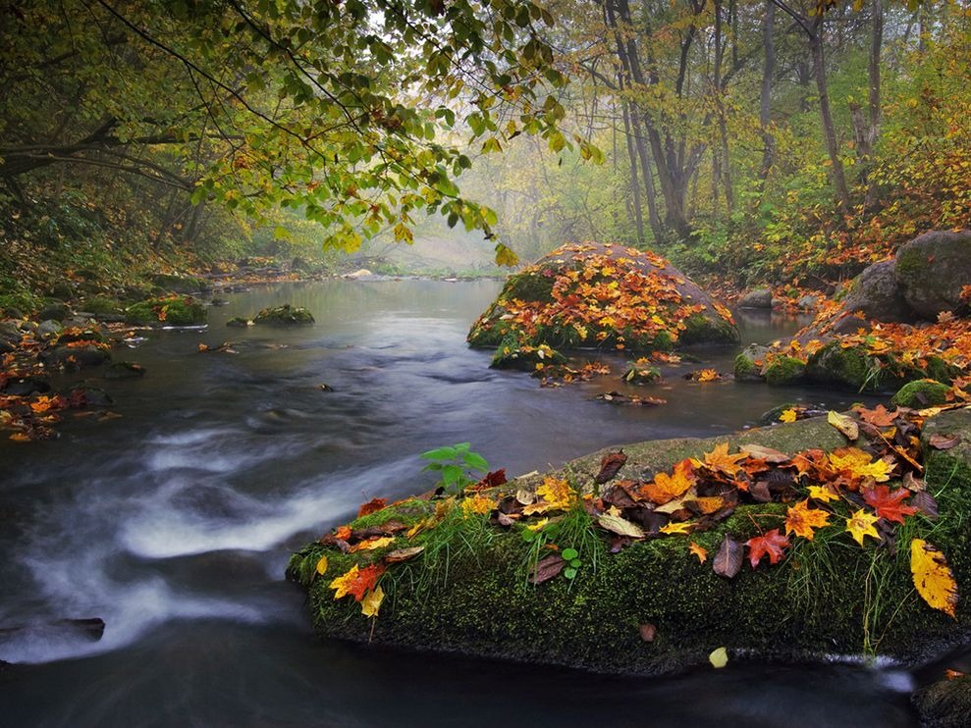
Purposes of the Millennium
NTS 424
Judge angels (1 Cor. 6:3)

Slide 46
"Don't you realize that someday we believers will judge the world? And since you are going to judge the world, can't you decide even these little things among yourselves? ³Don't you realize that we will judge angels? So you should surely be able to resolve ordinary disputes in this life"
(1 Cor. 6:2-3 NLT)

Slide 47
Purposes of the Millennium
NTS 424
Judge angels (1 Cor. 6:3)
Rule the earth (1 Cor. 6:2)
Restore world to pre-Flood era (long life of Isa. 65:20)

Slide 48
Incredibly Long Life (NIV)!
NTS 424
NIV Isaiah 65:20 "Never again will there be in [Jerusalem] an infant who lives but a few days, or an old man who does not live out his years; he who dies at a hundred will be thought a mere youth; he who fails to reach a hundred will be considered accursed."
Notes:
48

Slide 49
Purposes of the Millennium
NTS 424
Judge angels (1 Cor. 6:3)
Rule the earth (1 Cor. 6:2)
Restore world to pre-Flood era (long life of Isa. 65:20)
Show the human heart corrupt

Slide 50
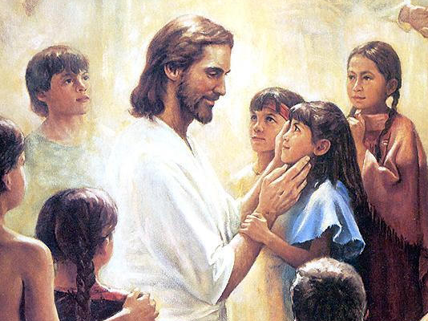
Christ will have a Spirit-led and righteous rule (11:1-5)
Christ will have a Spirit-led and righteous rule (Isa. 11:1-5)

Slide 51
Purposes of the Millennium
NTS 424
Judge angels (1 Cor. 6:3)
Rule the earth (1 Cor. 6:2)
Restore world to pre-Flood era (long life of Isa. 65:20)
Show the human heart corrupt
Fulfill Abrahamic Covenant

Slide 52


Abraham
Abraham
Heroes of the Faith
Notes:
In Genesis 12 the account switches directions from discussing all peoples to zeroing in on one man and his family—the man Abraham.

Slide 53
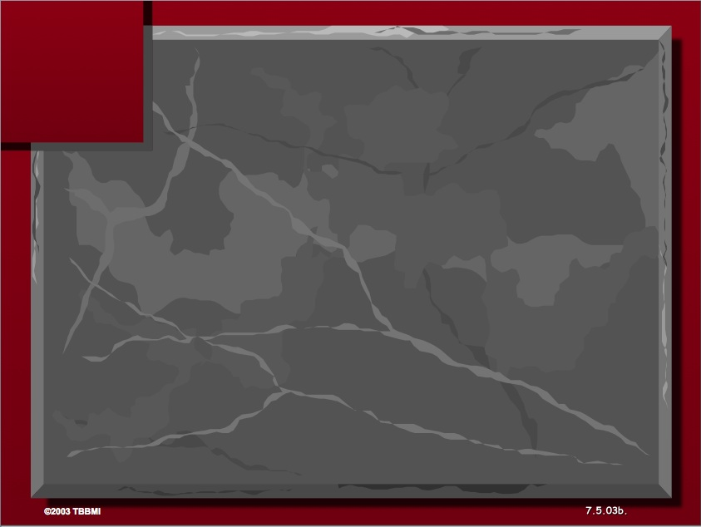
The Three Basic Elements
7
Genesis 12
The Lord had said to Abram,
"Leave your country, your people and your father's household, and go to the land I will show you.
1
A LAND
A SEED
"I will make you into a great nation
and I will bless you;
I will make your name great,
and you will be a blessing.
2
ABRAHAM
The CALL
I will bless those who bless you,
and whoever curses you I will curse;
and all peoples on earth
will be blessed through you."
L - S - B
3
A BLESSING
Handbook pg. 19-24
14
2

Slide 54


Borders of the Land Promised to Abraham
Genesis 15:18
"On that day the LORD made a covenant with Abram, saying, 'To your offspring I give this land, from the river of Egypt to the great river, the river Euphrates'" (ESV)

Slide 55
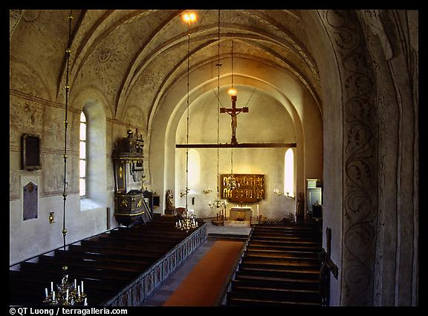
Covenants Fulfilled in the Millennium
60
Abrahamic
Land
Davidic
New
Land | Seed | Blessing
Physical | Political | Spiritual
Deut. 30 | 2 Sam. 7 | Jer. 31

Slide 56
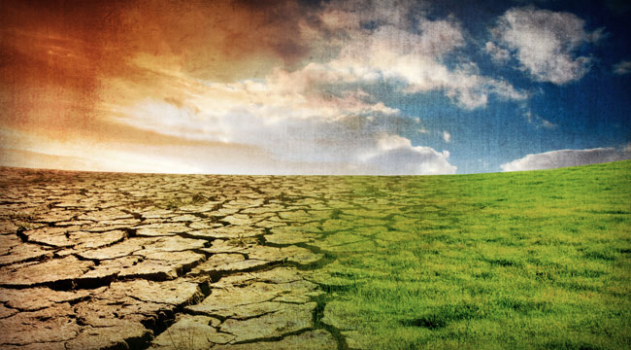
Isaiah's Key Idea
452
343
Judgment
Salvation
Notes:
In contrast to humanism, God says that he will judge the world, but then renew it—or restore it.

Slide 57
Key Word
452
343
Restoration
A Study of Isaiah

Slide 58

465
Promises of the Davidic Covenant
⁶ For a child is born to us,
a son is given to us.
The government will rest on his shoulders.
And he will be called:
Wonderful Counsellor, Mighty God,
Everlasting Father, Prince of Peace.
⁷ His government and its peace will never end.
He will rule with fairness and justice from the throne of his ancestor David for all eternity.
The passionate commitment of the Lord of Heaven's Armies
will make this happen! (Isa. 9:6-7)

Slide 59
Since Jesus will reign, you should serve him now so your can rule with him later (Isaiah 2:5)!

Slide 60

Jesus Shall Reign
CCLI Song #11026168
© 2010 Resolved Music
CIC CCLI Licence # 277507
Notes:
http://www.lyricsondemand.com/miscellaneouslyrics/christianlyrics/jesusshallreignwhereerthesunlyrics.html

Slide 61
Jesus Shall Reign
Jesus shall reign where'er the sun
Doth his successive journeys run
His Kingdom stretch from shore to shore,
Till moons shall wax and wane no more.
To Him shall endless prayer be made.
And princes throng to crown His head,
His name like sweet perfume shall rise
With every morning sacrifice.
Notes:
http://www.lyricsondemand.com/miscellaneouslyrics/christianlyrics/jesusshallreignwhereerthesunlyrics.html

Slide 62
Jesus Shall Reign
People and realms of every tongue
Dwell on His love with sweetest song;
And infant voices shall proclaim
Their early blessings on His name.
Blessings abound where'er He reigns:
The prisoner leaps to lose his chains,
The weary find eternal rest,
And all the sons of want are blest.
Notes:
http://www.lyricsondemand.com/miscellaneouslyrics/christianlyrics/jesusshallreignwhereerthesunlyrics.html

Slide 63
Jesus Shall Reign
Where He displays His healing power
Death and the curse are known no more;
In Him the tribes of Adam boast
More blessings than their father lost.
Let every creature rise and bring
Peculiar honors to our King;
Angels descend with songs again,
And earth repeat the loud Amen.
Notes:
http://www.lyricsondemand.com/miscellaneouslyrics/christianlyrics/jesusshallreignwhereerthesunlyrics.html

Slide 64
Black

Slide 65


Christology link at BibleStudyDownloads.org
Get this presentation for free!
Notes:
Creation (cr)

